Slide 1
CalendarMate
AI-Powered Productivity Assistant
Agentic AI Capstone Project Mahesh P Zade
Notes:
Introduce the project, the business problem, and your role as the project owner. State that CalendarMate is an Agentic AI productivity assistant built in Langflow and evaluated with Langfuse.

Slide 2
Agenda
Problem & business case
Solution and key capabilities
Agentic architecture and routing
Implementation, tools and prompts
Evaluation, observability and cost
Challenges, learnings and next steps
CalendarMate | Mahesh P Zade | 2
Notes:
Briefly walk through the presentation structure. Emphasize architecture and evaluation because these are central capstone requirements.

Slide 3
1. Problem Statement
Operational overload for PMs, TPMs and senior ICs
8–14 meetings/day
3–5 calendars
60+ emails/day
~2 hours/day
High meeting volume across teams.
Manual cross-referencing before scheduling.
Many are meeting-related.
Meeting logistics, scheduling and email triage.
Manual availability checks create double-booking risk.
Meeting action items and follow-ups can be missed.
People switch between calendar, email, and documents.
CalendarMate | Mahesh P Zade | 3
Notes:
The assignment problem statement identifies a heavy operational load. Explain that CalendarMate targets the repetitive coordination work so people can focus on higher-value delivery.

Slide 4
2. Business Case
Value hypothesis and measurable outcomes
Time reclamation
Scheduling safety
Faster triage
Measure minutes saved per PM/TPM per day.
Measure conflict/double-booking reduction.
Measure task completion latency and email handling time.
Planning ROI scenario: 50 users × 2 hours/day × $150/hour × 20 business days = $300,000/month of modeled gross value.
This is a planning scenario, not a measured production saving.
CalendarMate | Mahesh P Zade | 4
Notes:
Explain the three main business metrics. If asked about ROI, clearly call the $300,000/month number a planning scenario, not measured production ROI.

Slide 5
3. CalendarMate Solution
One natural-language entry point with specialist agent behavior
Briefing
Smart Scheduling
Email Triage
Follow-Up
Schedule overview, conflict awareness and focus summary.
Availability, conflict handling and controlled event creation.
Unread/important email summarization and prioritization.
Meeting summary and action-item drafting from supplied information.
Design principle: specialized responsibility + grounded tool use + observability.
CalendarMate | Mahesh P Zade | 5
Notes:
Describe CalendarMate as a workflow of specialized behaviors. Mention that briefing is handled by the Scheduler Agent in the actual exported graph.

Slide 6
4. Technology Stack
Workflow
Langflow
Low-code agent/workflow orchestration platform
LLM
OpenAI gpt-4o-mini
Reasoning, intent understanding and response generation
Observability
Langfuse
Execution traces, latency, tokens and cost monitoring
Workflow export
JSON
Portable Langflow workflow export for GitHub submission
Validated tools
Mock Calendar + Mock Gmail
Controlled tools used in the validated baseline test path
API components present
Google Calendar Read/Write + Gmail Read
Live integration components are present in JSON; not connected in the validated graph

Slide 7
5. Orchestration Pattern
Router / Dispatcher
Why Router?
Why not Sequential?
Why not Hierarchical?
Requests are heterogeneous. Each request should continue only through the relevant specialist.
A fixed sequence would execute unrelated agents and add unnecessary latency/cost.
The current request types do not require complex task decomposition.
Implementation detail: three parallel custom route filters feed Scheduler, Email and Follow-Up agents.
CalendarMate | Mahesh P Zade | 7
Notes:
Explain the orchestration decision. The assignment recommends Router/Dispatcher because requests vary. In this implementation, three route filters provide the dispatch behavior.

Slide 8
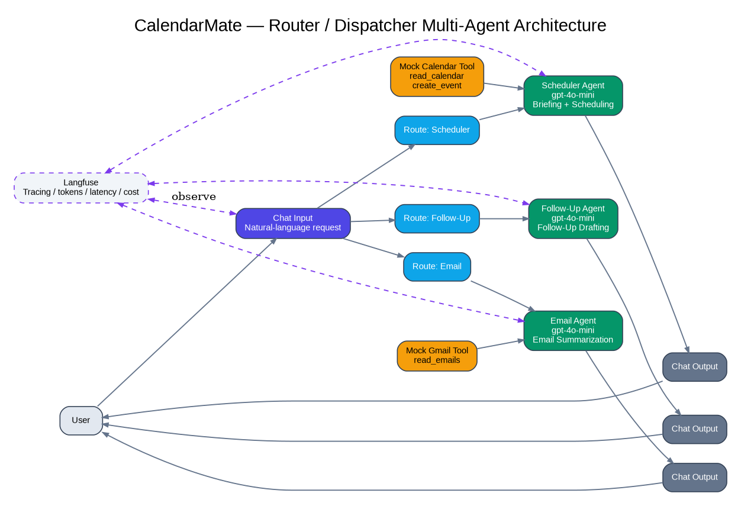
6. CalendarMate Architecture
Validated exported graph
CalendarMate | Mahesh P Zade | 8
Notes:
Walk left to right. User enters a request, Chat Input fans out to route filters, the matching route reaches one specialist agent, tools provide controlled data, Chat Output returns the response, and Langfuse observes execution.

Slide 9
7. Architecture — Component Responsibilities
Chat Input
Route Filters
Specialist Agents
Tools
Single natural-language entry point.
Scheduler / Email / Follow-Up intent dispatch.
Scheduler, Email, Follow-Up.
Mock Calendar / Mock Gmail in validated path.
Prompt Layer
Outputs
Observability
Grounding, scope and clarification rules.
Three Chat Output nodes return the selected result.
Langfuse traces, tokens, latency and cost.
Important boundary: live Google Calendar/Gmail nodes are present in the JSON but are not connected in the validated graph.
CalendarMate | Mahesh P Zade | 9
Notes:
Explain each layer. Call out the implementation boundary honestly: live API components are in the export but the validated test path uses mock tools.

Slide 10
8. End-to-End Request Flow
User request
Chat Input
Route filter
Specialist Agent
Tool call (if needed)
Grounded response
Chat Output
Langfuse trace
CalendarMate | Mahesh P Zade | 10
Notes:
Explain that the request is first routed, then handled by the appropriate specialist. Tool calls are used only where connected. Langfuse records the execution for evaluation and debugging.

Slide 11
9. Agent Responsibility Matrix
Scheduler Agent
Responsibility
Tool
Prompt rule
Briefing + scheduling
Mock Calendar
Grounded calendar output; availability before scheduling
Email Agent
Responsibility
Tool
Prompt rule
Email summarization
Mock Gmail
Tool-first; no fabricated emails
Follow-Up Agent
Responsibility
Tool
Prompt rule
Meeting follow-up drafting
None connected
No invented action items/deadlines/assignees
CalendarMate | Mahesh P Zade | 11
Notes:
Explain that the assignment permits combining or renaming agents. In the actual JSON there are three specialist agents; briefing is part of Scheduler Agent.

Slide 12
10. Prompt Engineering & Grounding
No Fabrication
Clarification
Tool-First
Never invent meetings, attendees, dates, email content, deadlines or assignees.
Ask for missing or ambiguous scheduling information instead of guessing.
Use the connected calendar/email tool before making data-grounded claims.
Prompt changes documented in the supplied evaluation evidence reduced early failure modes and routing mistakes.
CalendarMate | Mahesh P Zade | 12
Notes:
Explain why prompt engineering matters for an assistant that can act on schedules and summarize private information. Grounding rules are safety controls, not just style instructions.

Slide 13
11. Tool Integration & Implementation Boundary
Validated Calendar Tool
Validated Gmail Tool
Live API Nodes
Mock Calendar Tool connected to Scheduler Agent. read_calendar + create_event.
Mock Gmail Tool connected to Email Agent. read_emails.
Google Calendar Read/Write and Gmail Read are present in JSON but not connected in the validated graph.
Submission wording should distinguish 'components present' from 'end-to-end live integration validated'.
This makes the documentation technically defensible.
CalendarMate | Mahesh P Zade | 13
Notes:
This is an important transparency slide. Explain exactly what was validated and what remains to be wired for production. Do not claim live API transactions based only on the presence of nodes in the JSON.

Slide 14
12. Baseline Evaluation — T1 to T12
12 / 12
0
0
3+
Baseline tests reported as passed.
Failed tests reported.
Hallucination anomalies reported.
Additional edge cases documented.
Briefing
Scheduling
Email
T1, T2, T10, T12
T3, T4, T5, T6, T9, T11
T7, T8
CalendarMate | Mahesh P Zade | 14
Notes:
Summarize the supplied evaluation evidence: all 12 baseline tests are reported as passed. Mention that the evidence is based on the supplied controlled test artifacts.

Slide 15
13. Langfuse Observability
Latency
TTFT
Tokens
Observed cost
~4.0 sec
~1.28 sec
~2,890
~$0.000286
End-to-end sample trace
Time to first token
~2,770 input + ~120 output
Sample Langfuse cost/run
Langfuse provides execution traces for debugging, token monitoring, latency analysis and cost visibility.
CalendarMate | Mahesh P Zade | 15
Notes:
Use the reported trace metrics. Explain that the observed cost is empirical for the supplied trace and should not be treated as a permanent provider price.

Slide 16
14. Cost Analysis
15 runs/day
30 runs/day
30 × 20 days
≈ $0.00429/user/day
≈ $0.00858/user/day
≈ $0.1716/user/month
Based on the observed ~$0.000286/run figure in the supplied Langfuse report.
Production cost must also include hosting, API usage, and observability where applicable.
CalendarMate | Mahesh P Zade | 16
Notes:
Walk through the cost calculation. State clearly that the calculation is based on the observed Langfuse cost per run and is an estimate.

Slide 17
15. Cost–Benefit Analysis: Build Cost vs. Productivity Savings
CalendarMate | Illustrative planning model — replace hourly rates with company actuals
Current TPM effort
~2 hours/day on meeting logistics. Estimated saving: ~50–95 min/day (hypothesis).
AI Engineer — 2-week build
10 working days × 8 h = 80 h Illustrative loaded cost: $50/h Build cost ≈ $4,000
Illustrative annual labor value
At $50/h TPM loaded value: 190 h → $9,500/year 300 h → $15,000/year 365 h → $18,250/year
Annualized time recovered
~190 h/year at 50 min/day ~300 h/year at ~80 min/day ~365 h/year at 95 min/day
LLM operating cost
Observed Langfuse sample: ~$0.000286/run 15 runs/day × 230 days ≈ $0.99/year/user Actual cost varies with usage.
Year-1 net value after build
Annual labor value − $4,000 build cost − LLM cost ≈ $5,499 to $14,249 per TPM/year (before other infrastructure costs)
Business case: Annual benefit = hours saved × loaded TPM hourly value
Year-1 net value ≈ Annual labor value − one-time AI build cost − annual LLM/infrastructure cost
Assumptions: 80 AI-engineer hours; $50/h engineer and $50/h TPM are illustrative; 230 working days/year. Savings are a hypothesis until measured.
CalendarMate | Mahesh P Zade

Slide 18
16. Challenges → Solutions → Learning
Routing
Challenge
Solution
Learning
Some intents could overlap
Tightened route keywords and intent rules
Clearer dispatch boundaries
Hallucination control
Challenge
Solution
Learning
Agent could infer plausible details
Added explicit grounding rules
Tool-grounded responses
Observability
Challenge
Solution
Learning
Trace setup/configuration required troubleshooting
Configured Langfuse variables and verified traces
Better debugging visibility
Integration boundary
Challenge
Solution
Learning
Live nodes vs validated path
Documented mock vs live path explicitly
More accurate technical claims
CalendarMate | Mahesh P Zade | 18
Notes:
Use these as concrete project lessons. The integration-boundary lesson is especially important: documentation must match the actual graph and evidence.

Slide 19
17. Two-Week Improvement Plan
Week 1 — Production Integration & Safety
Week 2 — Grounding & Optimization
• Connect live Google Calendar/Gmail components. • Validate OAuth2 and least-privilege scopes. • Add human approval for calendar writes. • Re-run T1–T12 on the live path. • Capture fresh Langfuse traces.
• Add RAG where justified. • Improve conflict resolution. • Optimize prompts and token usage. • Add more edge cases. • Establish user feedback and pilot metrics.
CalendarMate | Mahesh P Zade | 19
Notes:
Explain the roadmap as the next step from capstone prototype to production-ready pilot. Week 1 closes the live-integration and safety gap; Week 2 focuses on grounding and optimization.

Slide 20
Thank You
Special thanks to Gautam Muthukumar
for valuable guidance, continuous support, and encouragement throughout the CalendarMate Capstone Project.
Sincere thanks to the Interview Kickstart Team for the learning platform, resources, mentorship, and opportunity.
Mahesh P Zade
Notes:
Close by thanking Gautam Muthukumar for guidance and the Interview Kickstart Team for the learning opportunity, resources and support. Then invite questions.

